Slide 1
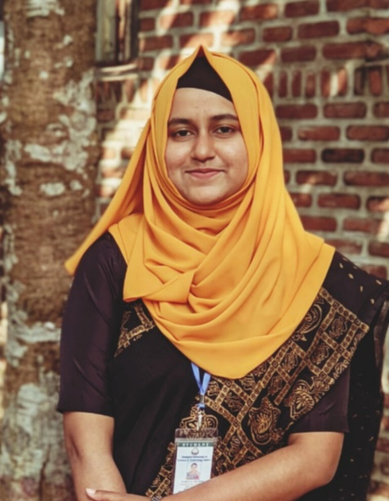
Curriculum Vitae
Farjana Akther
Netrakona Sadar, Netrakona
Mobile: 01743777181
E-mail: Farjjj5779@gmail.com

Slide 2
To obtained a standard job in any well-known organization where I can apply my creative skills and competency.
Professional Objective

Slide 3
Personal Precise
Full Name : Farjana Akter
Father’s Name : Harun-Or –Rashid
Mother’s Name : Nazma Begum
Mailing Address : Second Ladies Hall, SUST, Sylhet
Permanent Address : Netrakona Sadar, Netrakona
Date Of Birth : 01-01-2001
Nationality : Bangladeshi
Marital Status : Unmarried
Religion : Islam

Slide 4
Academic Qualification
Name of Degree | Board/ University | Passing Year | GPA/Class
B.A.(Hon’s) | Shahjalal University of Scienc and Technoogy, Sylhet | 2025 | 1st Class
HSC | Netrakona Govt, Mohila College, Netrakona | 2019 | 4.17
SSC | Maoha High Scool, Gouripur, Mymensingh | 2017 | 5.00

Slide 5
Computer Literacy
Major courses on computer are completed.
Successfully completed course on “EDGE Smart Office Management”.
Completed a basi course on “Certificate in Computer Application” from Bangladesh Computer Council.

Slide 6
Language Proficiency
Excellent communication skills in English and Bangla both written and verbal.

Slide 7
Value Offered
Having three years (2022-25) experience as an organizer in leading blood managing group of SUST named “Sanchalon” .
Having one year (2023) experiencee as a Finance Secretary in “Torun Column Lekhok Forum” in SUST branch.

Slide 8
References
1. Name: Dr. Najmunnahar Begum
Designation: Chairman of Bangla at SUST
Mobile: 01689467688
E-mail: Nbegum8766@gmail.com
2. Name: Sheikh Gulzar Rahman
Designation: Business Development Manager
Company: Google Inc.
Mobile: 01757797957
E-mail: Rahman678@gmail.com

Slide 9
THANK YOU

